Slide 1

Data-Driven Behavioral Analytics:
Observations, Representations and Algorithms
for Suspicious Behavior Detection
Meng Jiang
University of Illinois at Urbana-Champaign
Welcome to visit my homepage www.meng-jiang.com !

Slide 2
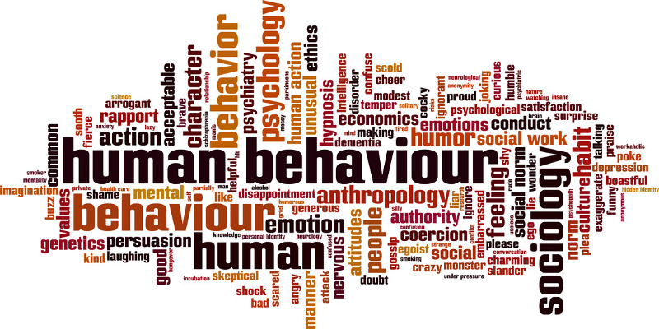
Behavior
Human behavior refers to the array of every physical action … associated with individuals, as well as the human race as a whole. (From Wikipedia)

Slide 3




Behavioral Analytics
Methodology
Understanding
Observations
Who, what, where, when, why, how… (scientific view)
Modeling
Representations
Graph, network, matrix, tensor… (mathematical view)
Intervening
Algorithms
Classification, prediction, recommendation,
anomaly detection… (application view)
#
t

Slide 4
Behavioral Analytics/Modeling

Slide 5

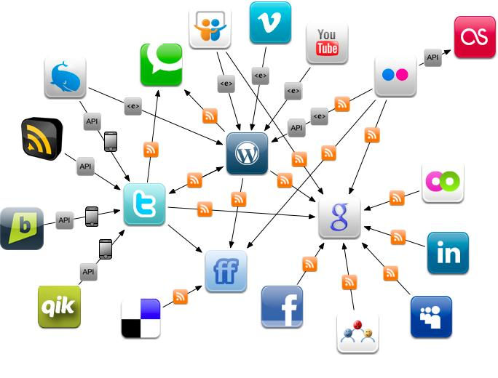
From Experience-Driven to Data-Driven
Physical World
Online Behavioral Data
The human behaviors are broadly and deeply
recorded in an unprecedented level.
This is the first time that we can get insights of human behaviors and the society from large scale real data.

Slide 6
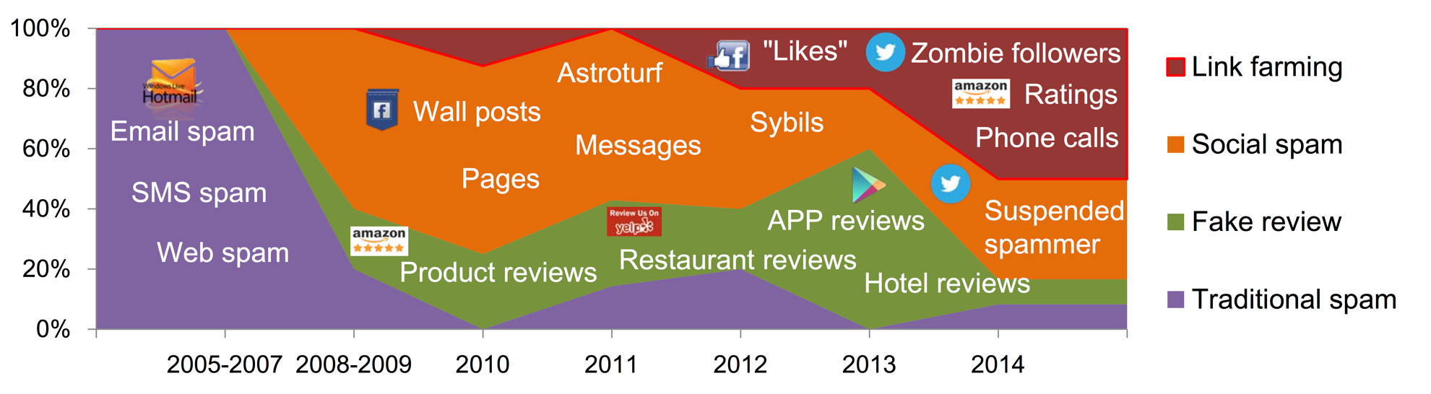
Data-Driven Approaches for Suspicious Behavior Detection
Meng Jiang, Peng Cui and Christos Faloutsos.
Suspicious Behavior Detection: Current Trends and Future Directions.
IEEE Intelligent Systems (ISSI), 2016.

Slide 7
Data-Driven Approaches for Suspicious Behavior Detection
Social Link Farming
Meng Jiang, Peng Cui and Christos Faloutsos.
Suspicious Behavior Detection: Current Trends and Future Directions.
IEEE Intelligent Systems (ISSI), 2016.

Slide 8
Roadmap
Can we spot and catch the suspicious behaviors in a scalable and principled way?
Behavioral patterns
W1. Spotting and catching synchronized behaviors (KDD’14 Best Paper Finalist)
W2. Evaluating suspiciousness in multiple dimensions (ICDM’15, TKDE’16)
W3. Representing and summarizing dynamic and multi-contextual behaviors (KDD’16)

Slide 9
Roadmap
Can we spot and catch the suspicious behaviors in a scalable and principled way?
Behavioral patterns
W1. Spotting and catching synchronized behaviors (KDD’14 Best Paper Finalist)
W2. Evaluating suspiciousness in multiple dimensions (ICDM’15, TKDE’16)
W3. Representing and summarizing dynamic and multi-contextual behaviors (KDD’16)

Slide 10

Social Link Farming
Selling Twitter followers

Slide 11
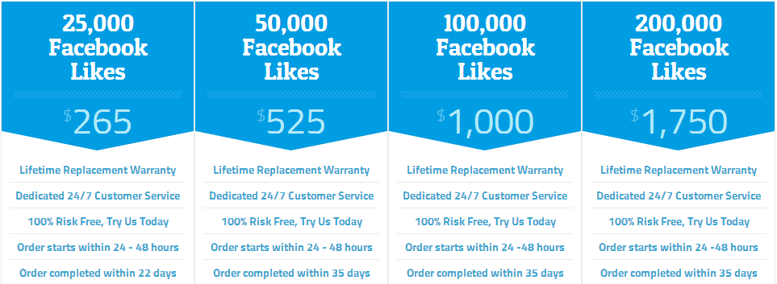
Social Link Farming
Selling Facebook Likes

Slide 12
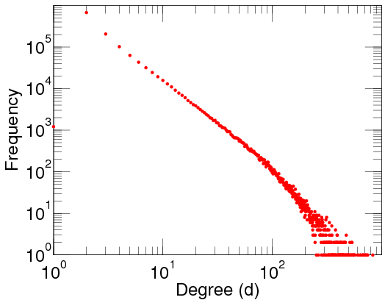
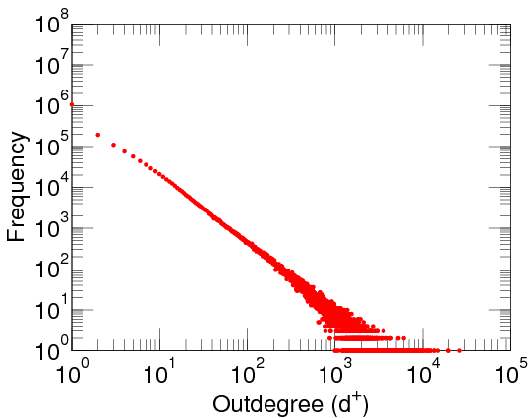
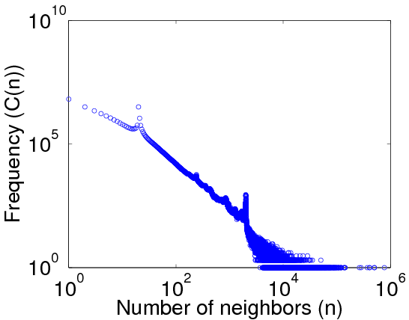
Observation: Power-Law Distribution
Out-degree distribution
DBLP Author-publication | Flickr User-user | Twitter Who-follows-whom
[konect.uni-koblenz.de/networks/]

Slide 13


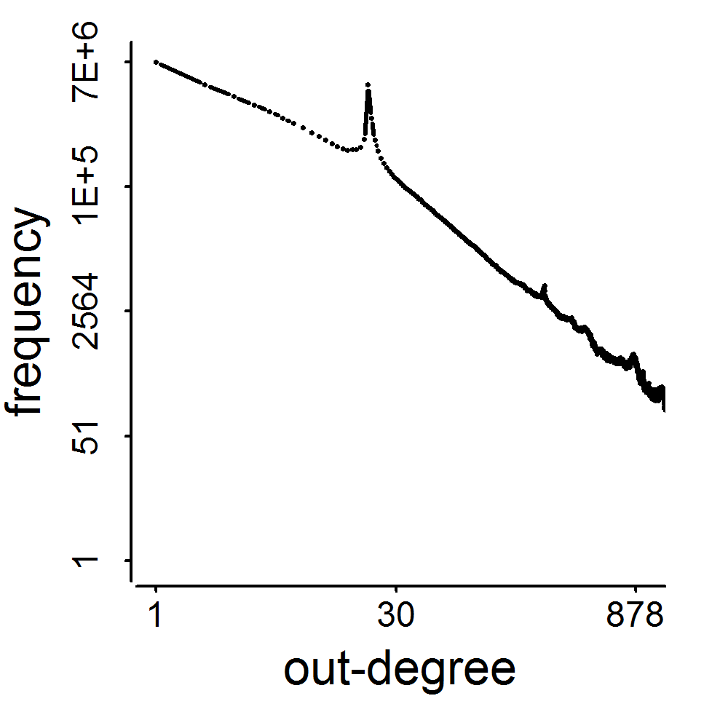
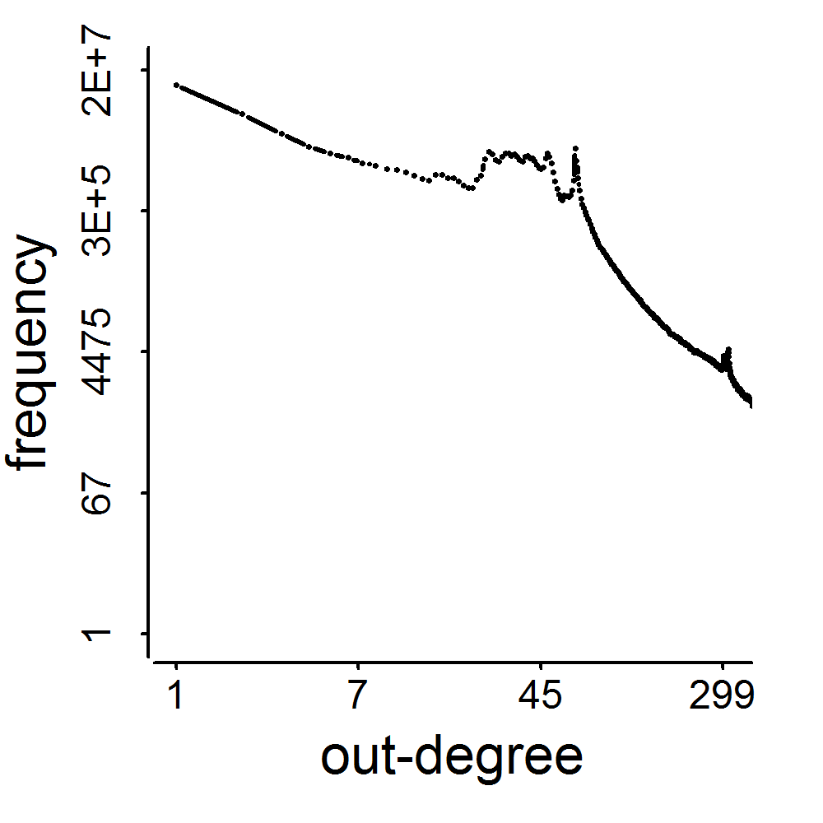
2009
41M
2011
117M
3.17M
1.91M
0.41M
0.44M
d=20
d=64

Slide 14
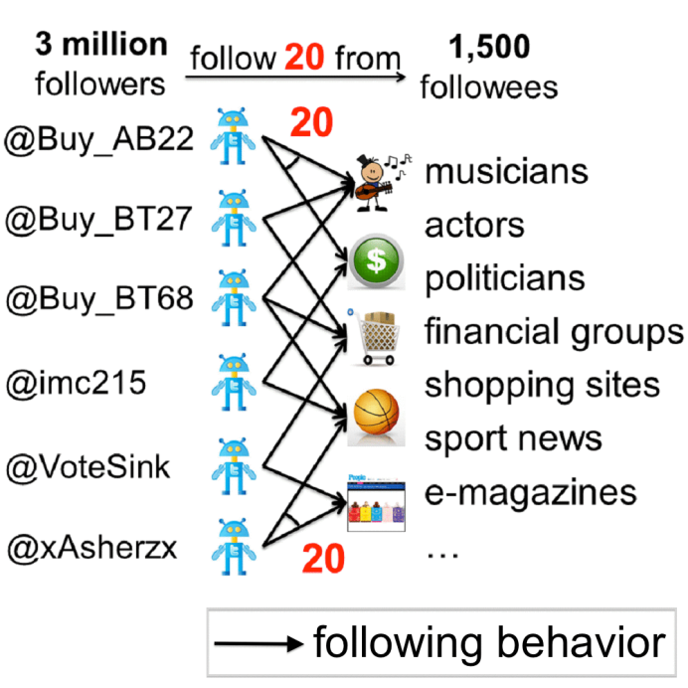
Observation: Smart Zombie Followers
Taking them individually, it’s difficult to tell whether they are fake followers
Silent: very few tweets
Ordinary: very few followers
Unaggressive: only 20/1,500
Traditional features and classifiers fail
#hashtag, #URL…
Out-degree, in-degree…

Slide 15
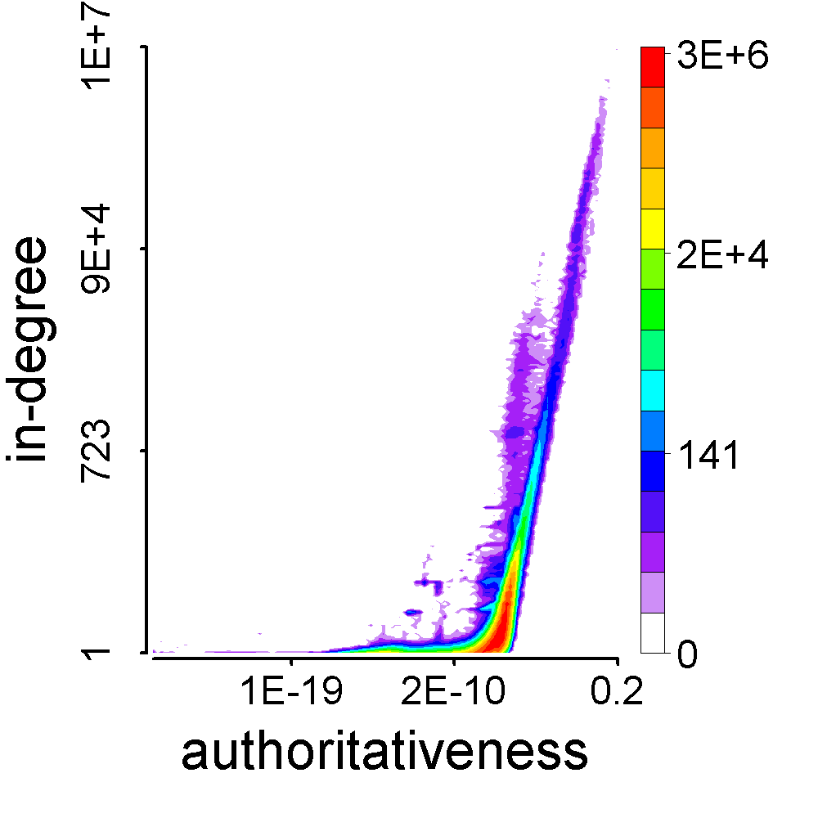
Observation: Feature Space of Followees
President Obama
Meng Jiang

Slide 16

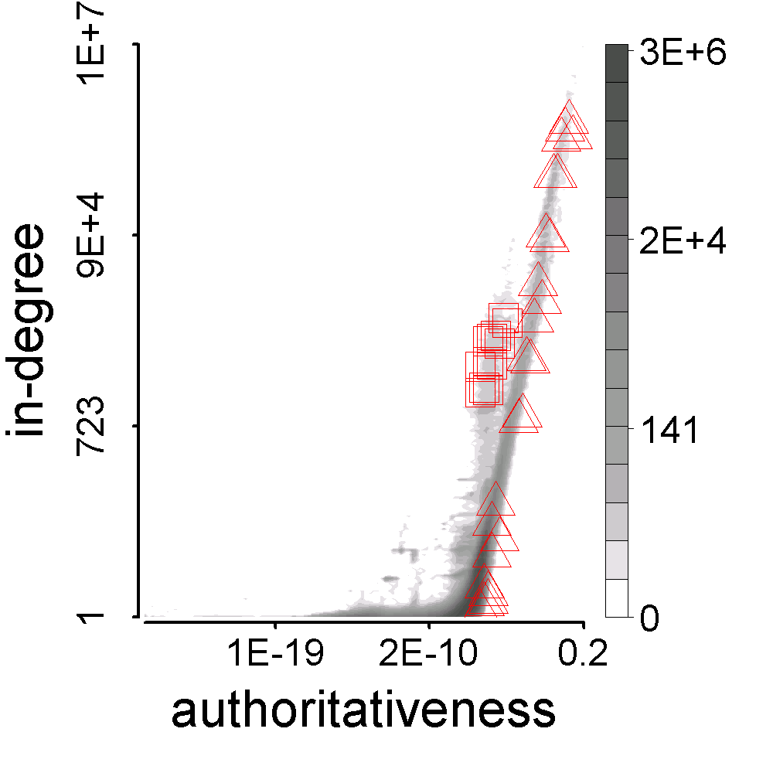
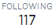

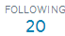
Observation: Who Are Their Followees
Buy AB22’s followees
Synchronized
Abnormal

Slide 17
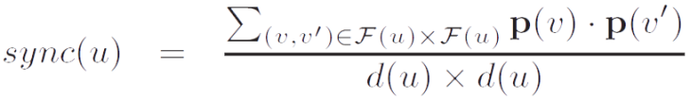
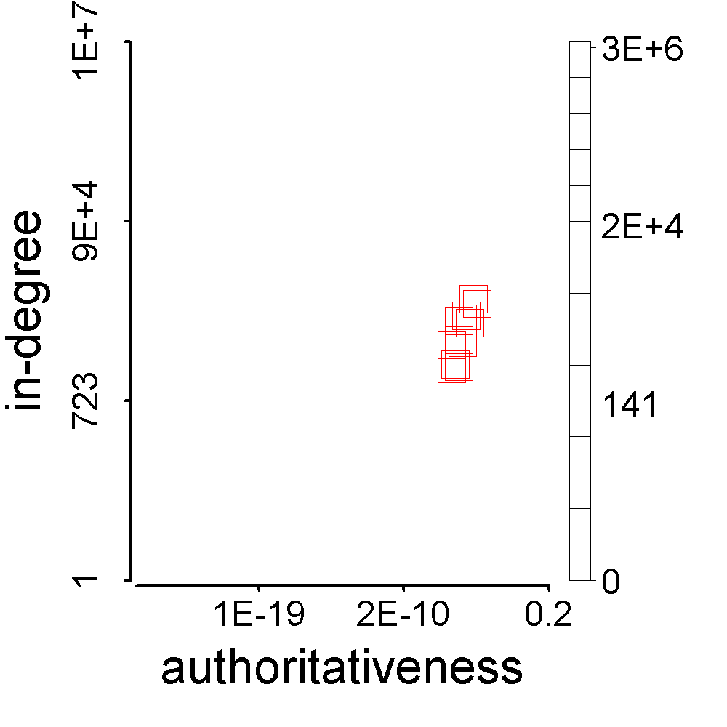
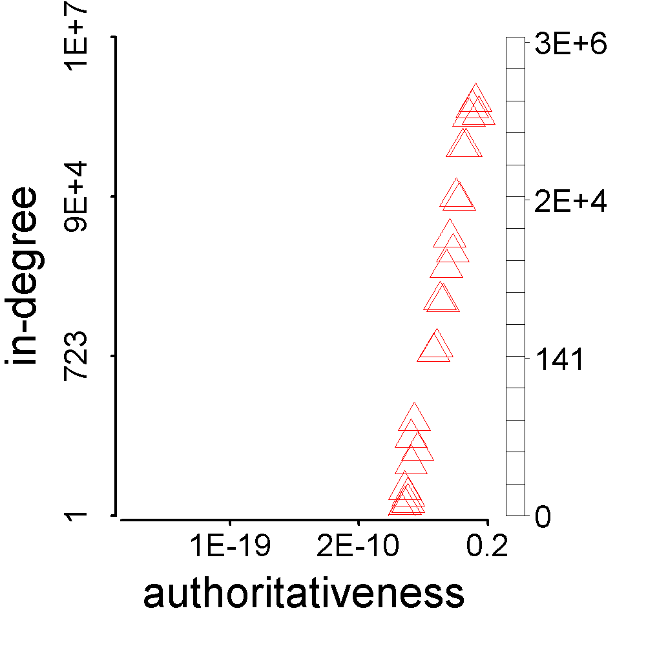
Representation: Synchronicity
>

Slide 18
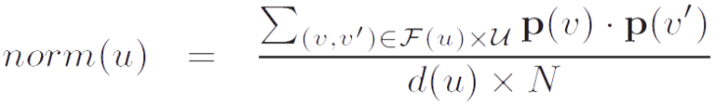
Representation: Normality
<

Slide 19
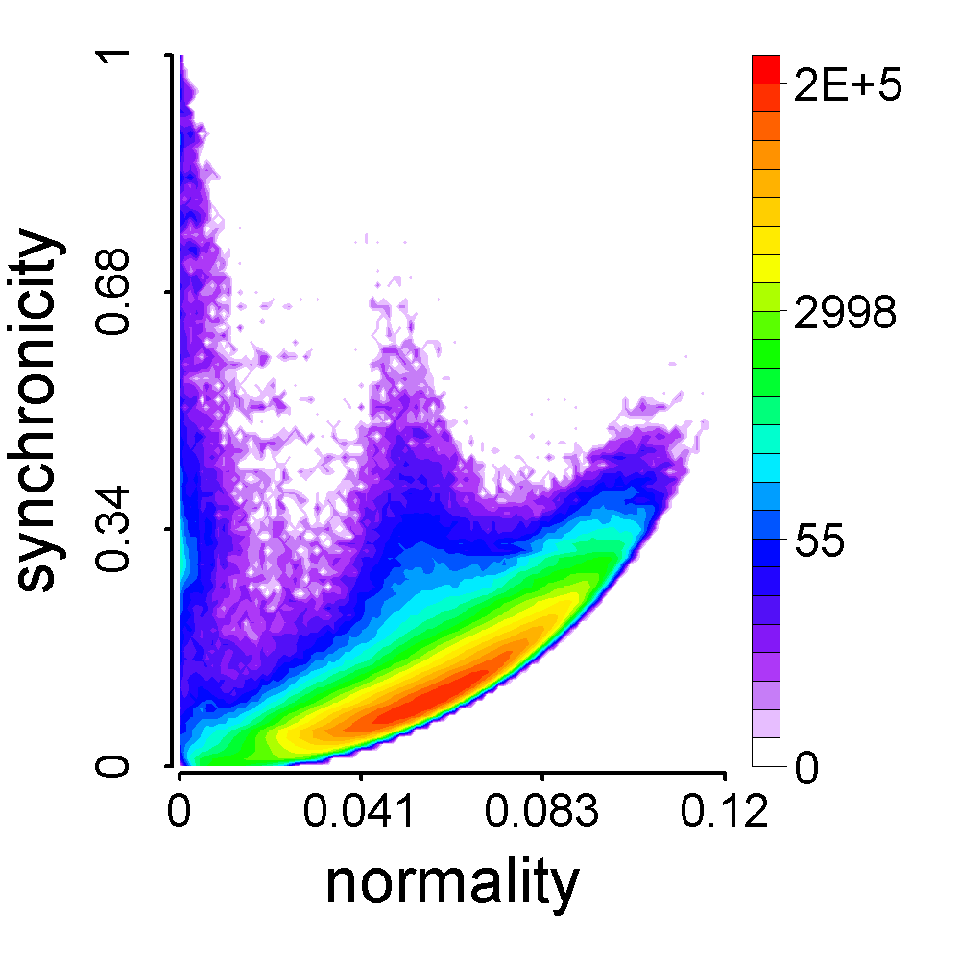
Algorithm: CatchSync
Synchronicity-Normality: theoretical parabolic lower limit

Slide 20
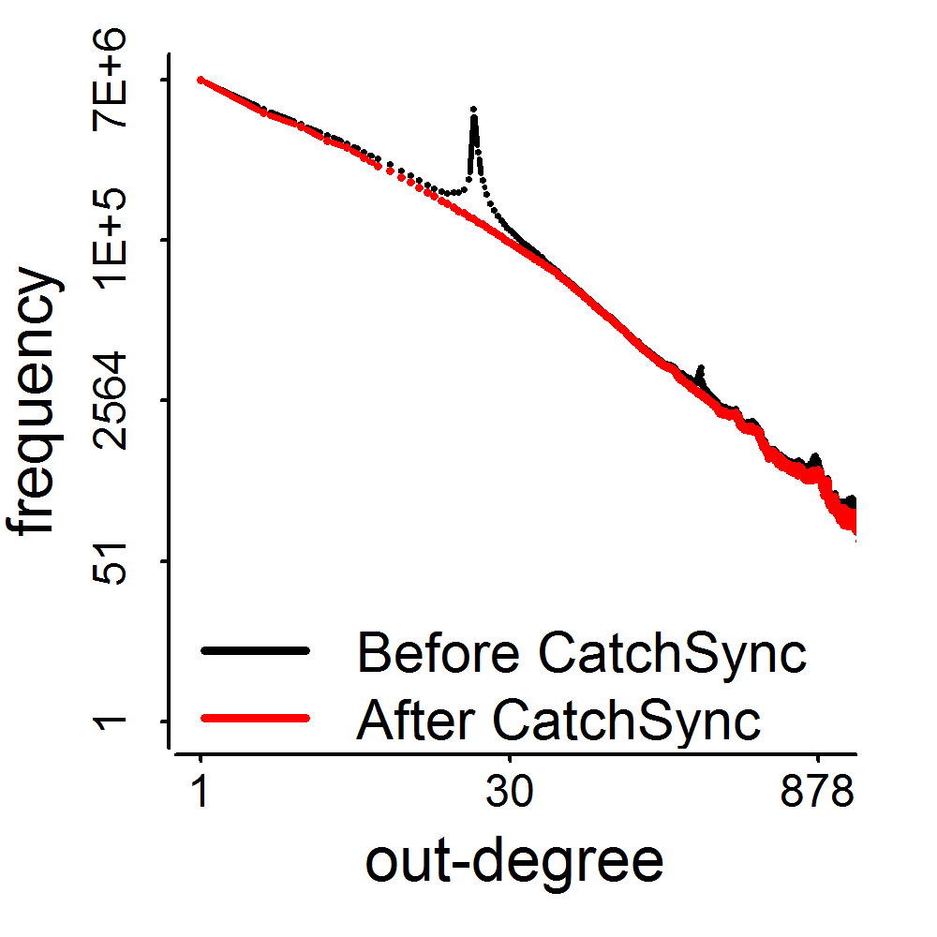
Results
3.17M
0.41M
d=20

Slide 21
Roadmap
Can we spot and catch the suspicious behaviors in a scalable and principled way?
Behavioral patterns
W1. Spotting and catching synchronized behaviors (KDD’14 Best Paper Finalist)
W2. Evaluating suspiciousness in multiple dimensions (ICDM’15, TKDE’16)
W3. Representing and summarizing dynamic and multi-contextual behaviors (KDD’16)

Slide 22
Suppose You Work in Twitter
My boss wants me to
catch fraud in such a big table – billions of records, tens of columns!!! How?!

Slide 23
Observation: Multidimensional Data
Dataset | Dimension/Mode (column names) |  |  |  | Mass (#line)
Weibo’s Retweeting | User | Root ID | IP | Time (min) | #retweet
 | 29.5M | 19.8M | 27.8M | 56.9K | 211.7M
Weibo’s Trending (Hashtag) | User | Hashtag | IP | Time (min) | #tweet
 | 81.2M | 1.6M | 47.7M | 56.9K | 276.9M
Network attacks (LBNL) | Src-IP | Dest-IP | Port | Time (sec) | #packet
 | 2,345 | 2,355 | 6,055 | 3,610 | 230,836

Slide 24


Representation: Dense Block Indicates Suspiciousness
200 minutes
120 minutes
time
time
user
225
user
40
IP
12,375
2
27,313
Q: Which is more suspicious?
We need a metric to evaluate the suspiciousness.

Slide 25
Criteria for Suspiciousness Metric
What properties are required of a good metric?
N₁ ⨉ N₂ ⨉ N₃
Count data with total “mass” C
f(
)
f(
n’₁ ⨉ n’₂ ⨉ n’₃
mass c’
density ρ’
)
n₁ ⨉ n₂ ⨉ n₃
mass c
density ρ
vs

Slide 26
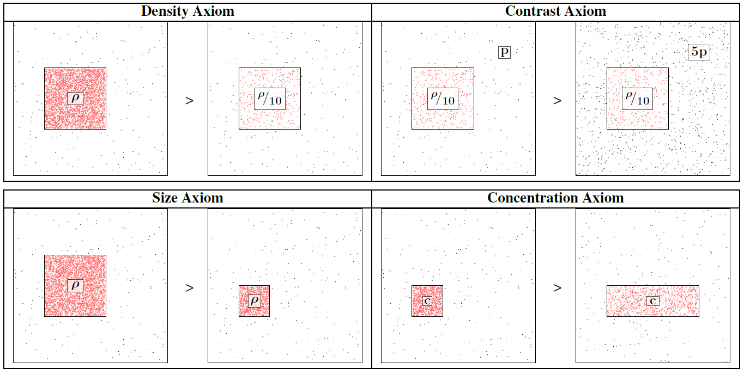
Axiom 1-4

Slide 27
Axiom 5: Cross Dimensions
Not including a mode is the same as
including all values for that mode.
=
▶ New information (more modes) can only
make our blocks more suspicious

Slide 28
Scoring the Suspiciousness
200 minutes
120 minutes
time
time
user
225
user
40
IP
12,375
2
27,313
Q: Which is more suspicious?

Slide 29
Scoring the Suspiciousness
200 minutes
120 minutes
time
time
user
225
user
40
IP
12,375
2
27,313
Probability
0.9%
0.05%

Slide 30
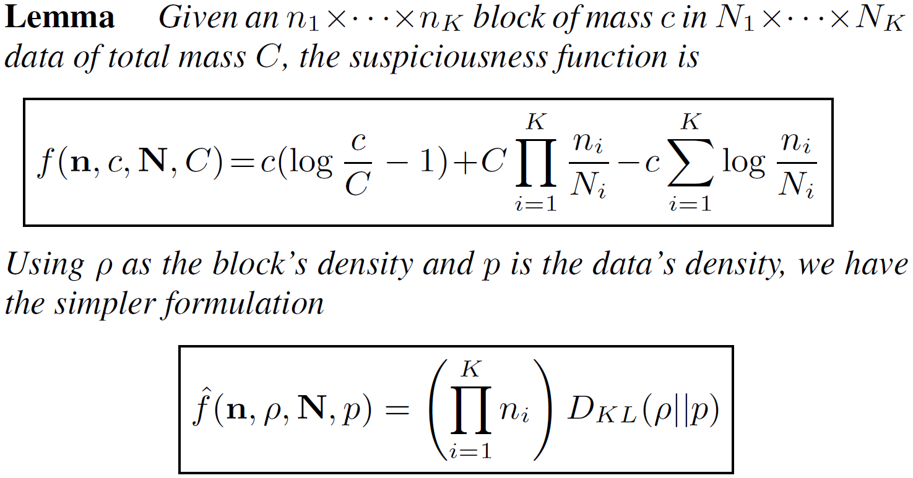
A General Suspiciousness Metric
Negative log likelihood of block’s probability

Slide 31
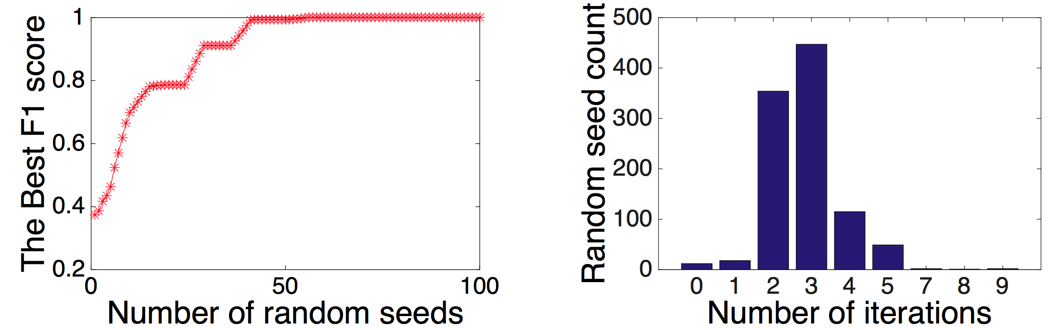
Algorithm: CrossSpot
Local search to maximize the metric
Start with seed blocks
Parameter-free: iteratively update the blocks
Scalable: parallelize to multiple machines

Slide 32
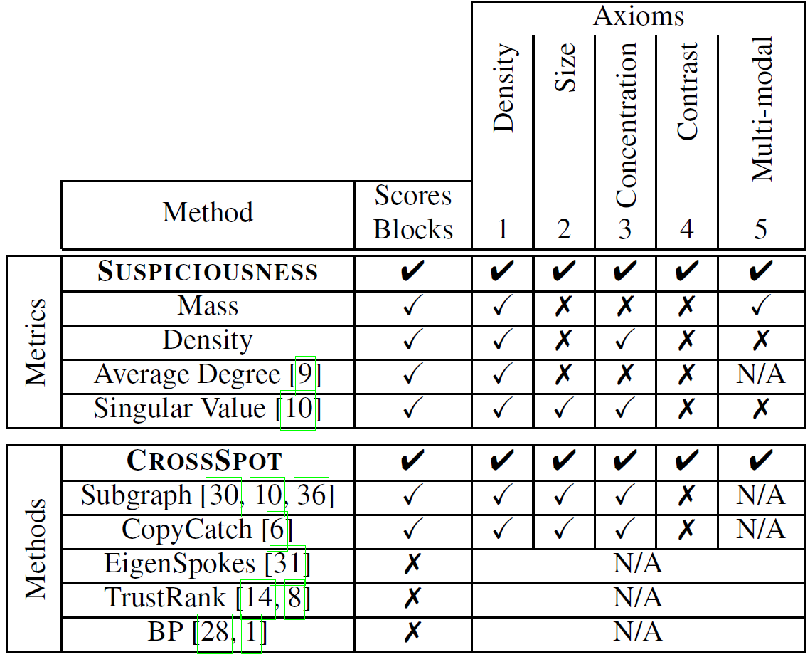
Advantages

Slide 33
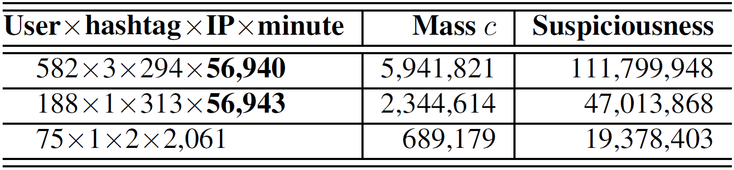
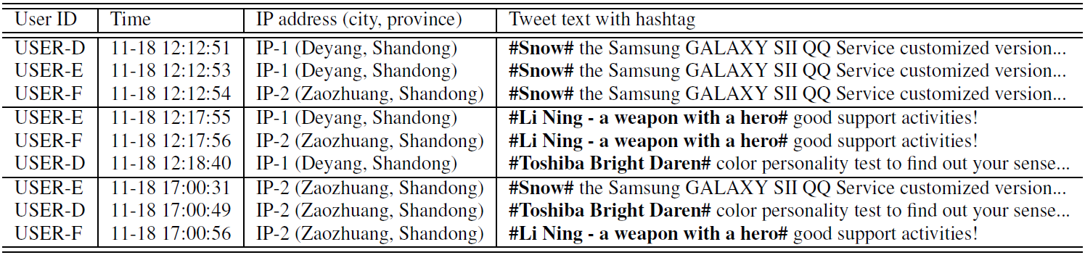
Results

Slide 34
Results

Slide 35
Roadmap
Can we spot and catch the suspicious behaviors in a scalable and principled way?
Behavioral patterns
W1. Spotting and catching synchronized behaviors (KDD’14 Best Paper Finalist)
W2. Evaluating suspiciousness in multiple dimensions (ICDM’15, TKDE’16)
W3. Representing and summarizing dynamic and multi-contextual behaviors (KDD’16)

Slide 36
Rethink about the Representations
Graph/Matrix
Matrix/Tensor
time
user
time
user
IP
Q: Can they represent every human behavior?
We need to check the basic characteristics of behavior.

Slide 37
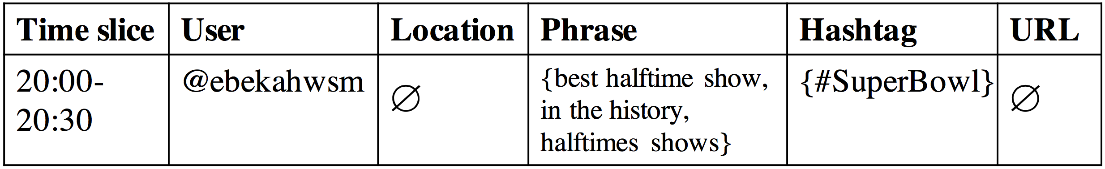
Observation: Dynamic and Multi-contextual
Tweeting behavior
20:03:09 @ebekahwsm
this better be the best halftime show ever in the history of halftimes shows. ever. #SuperBowl
Contextual factors:
t
u
p
h
p
p
One-guaranteed
value
Empty (set
of) value
Empty (set
of) value
Set value
Dynamic

Slide 38
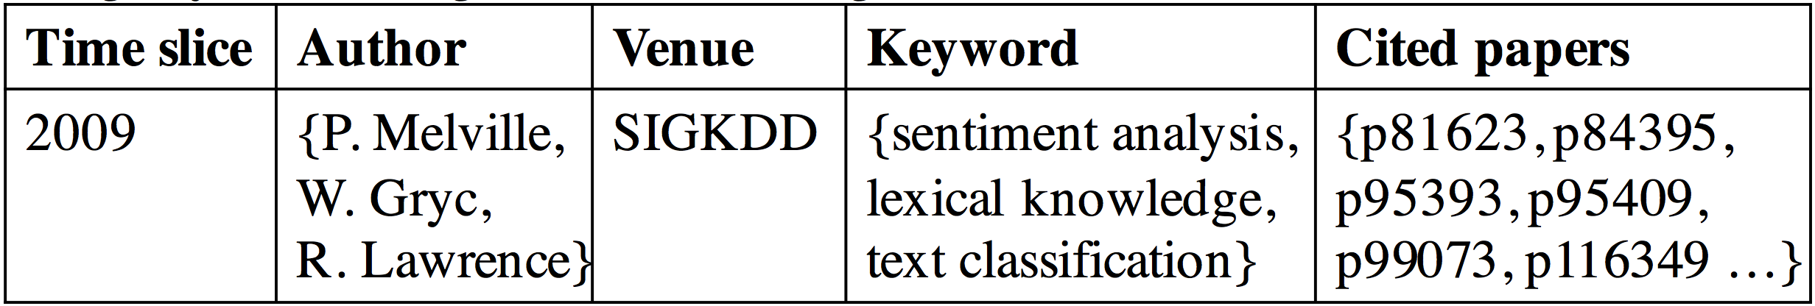
Observation: Dynamic and Multi-contextual
2009 P. Melville, W. Gryc, R. Lawrence, “Sentiment analysis of blogs by combining lexical knowledge with text classification”, KDD’09. Refs: p81623, p84395…
Publishing-paper behavior
Contextual factors:
t
c
a
c
One-guaranteed
value
a
a
v
p
p
p
Set value
Set value
Set value
Dynamic

Slide 39
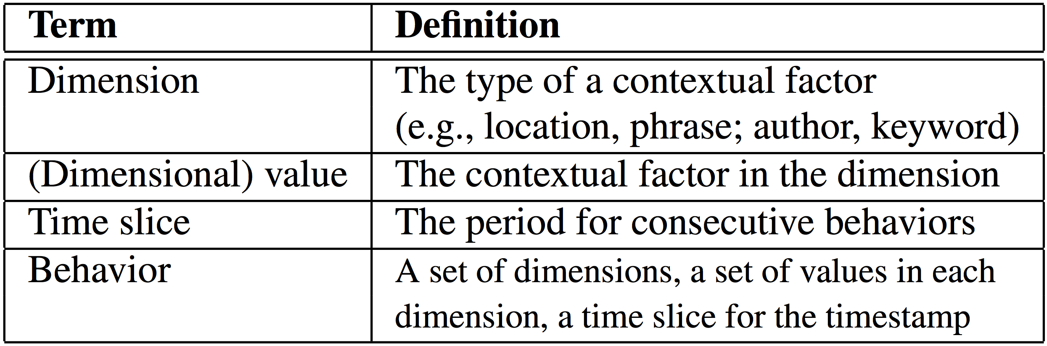
Observation: Dynamic and Multi-contextual
Dynamic: taking a set of consecutive time slices
Multi-contextual: taking a set of dimensions and a set of dimensional values in each dimension

Slide 40
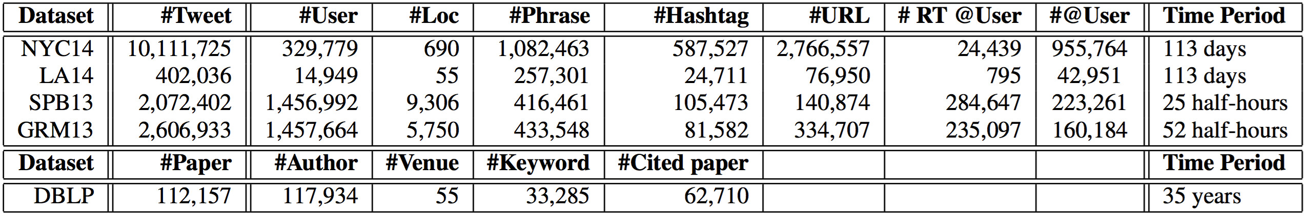
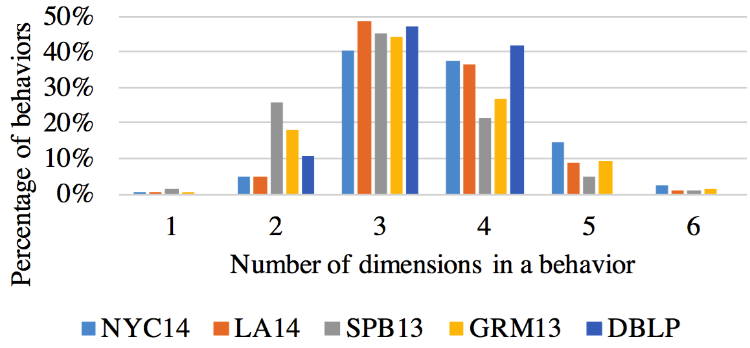
Observation: Dynamic and Multi-contextual

Slide 41
Tensor Fails
Multi-contextual
Set value
Empty value
Dynamic
Temporal values
t₁₀
t₁₁
t₂₄
t₂₅
t₂₆
t₃₁
t₃₇
∅
∅
∅

Slide 42
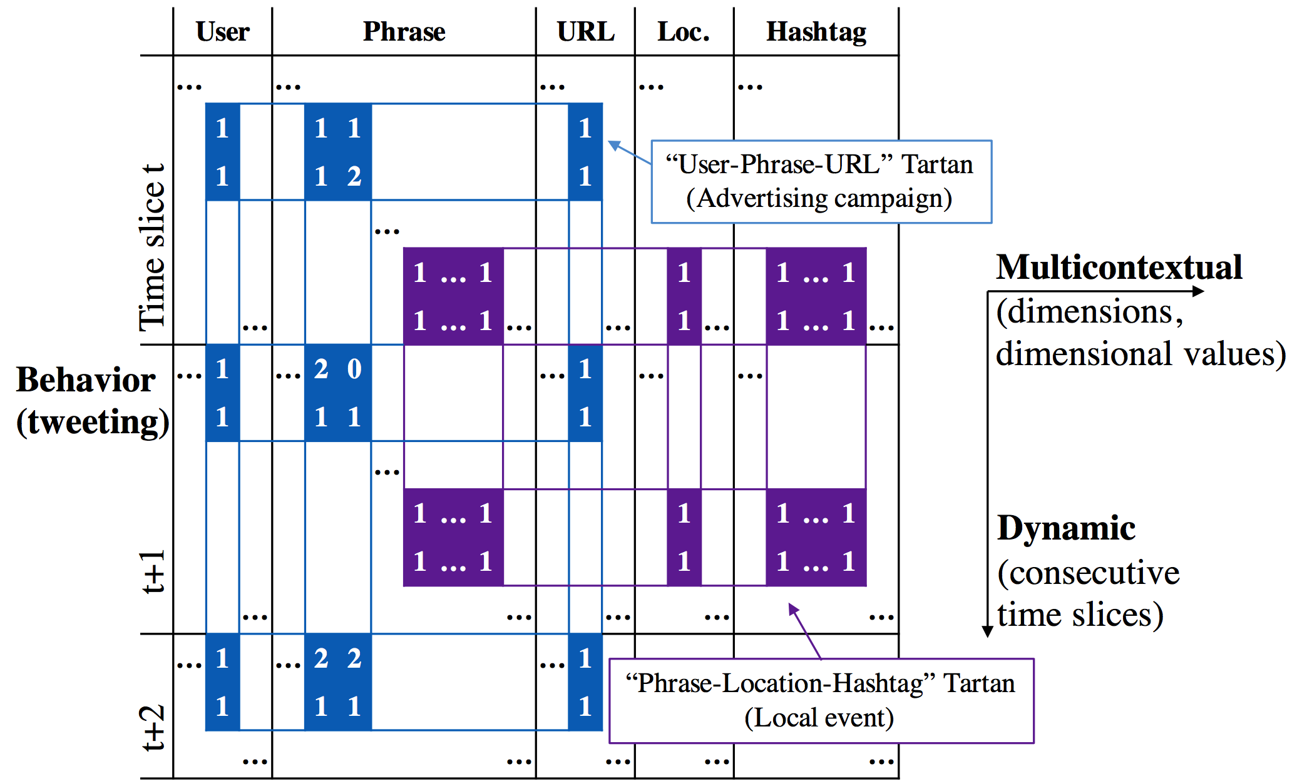
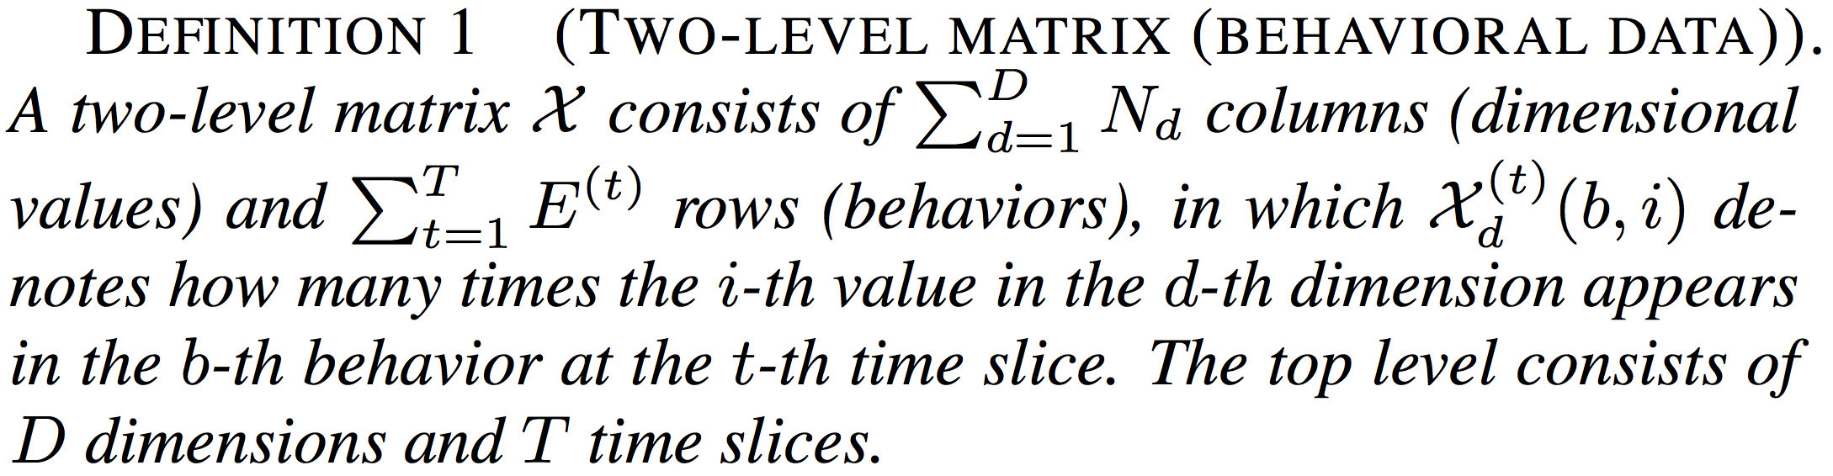
Representation: “Two-Level Matrix”

Slide 43
Representation: “Two-Level Matrix”

Slide 44
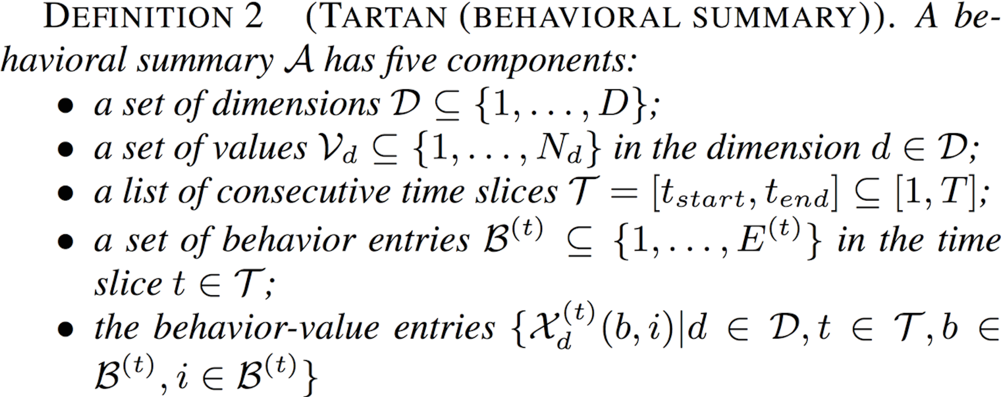
Representation: “Tartan”

Slide 45
Representation: “Tartan”

Slide 46
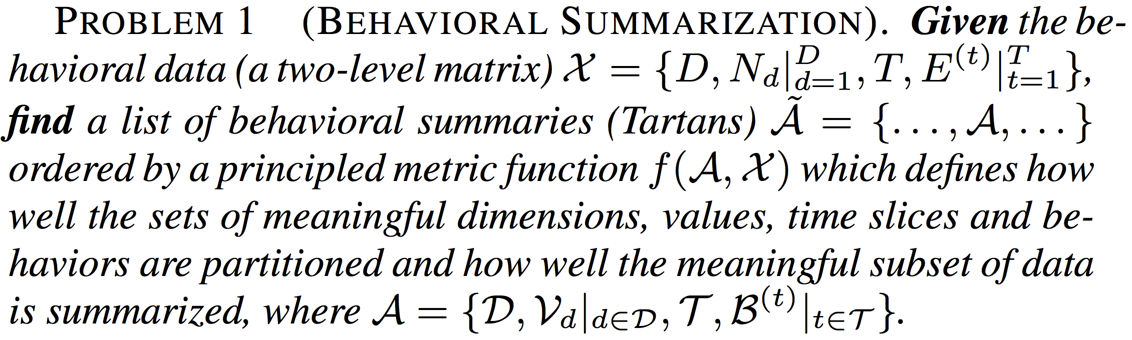
The Summarization Problem
Given the “Two-Level” Matrix, find the Tartans
Tartan: sets of meaningful dimensions, values, time slices and behaviors
Principle matric function f(Tartan, Data)

Slide 47
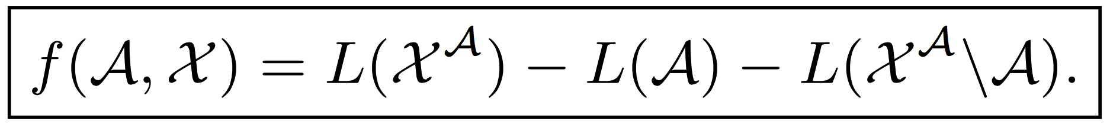
Algorithm: CatchTartan
Employing a lossless encoding scheme based on the Minimum Description Length (MDL) principle
Estimating the number of bits that encoding the Tartan can save from merging the meaningful pattern into the encoding of the data
Tartan
Data
First-level matrix
Individual entries

Slide 48
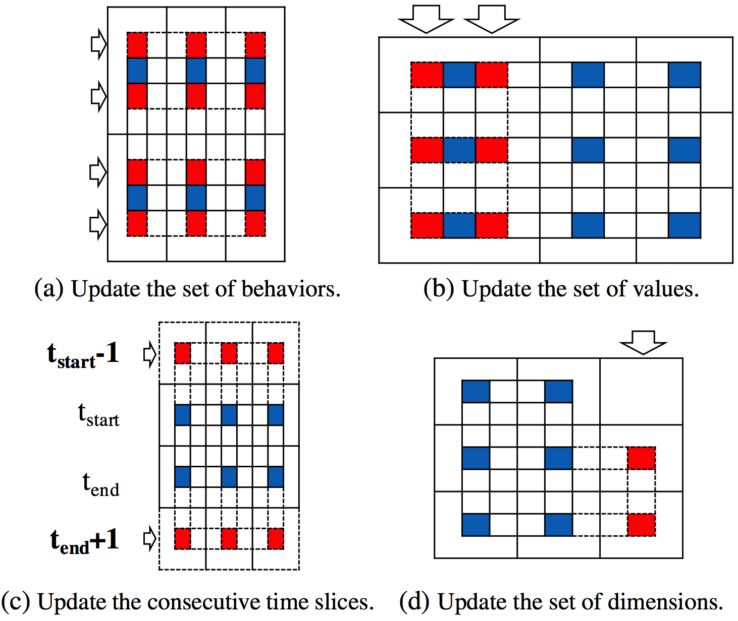
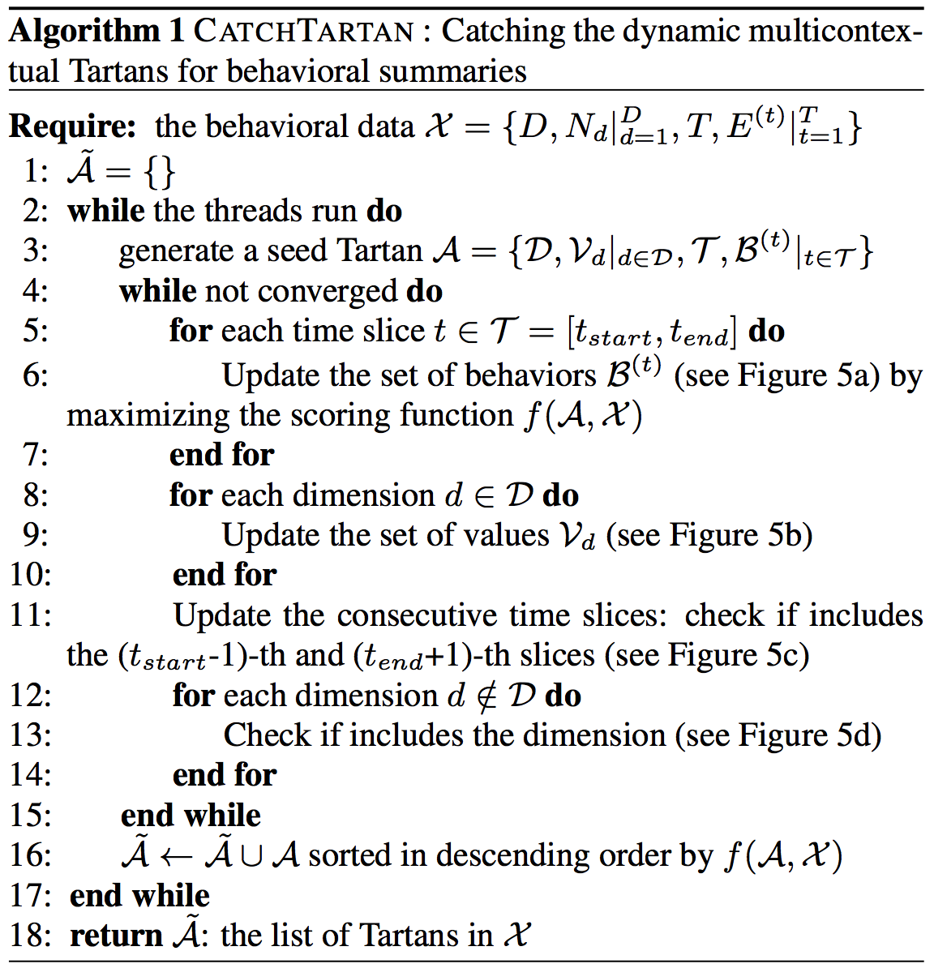
Algorithm: CatchTartan
Time complexity:

Slide 49
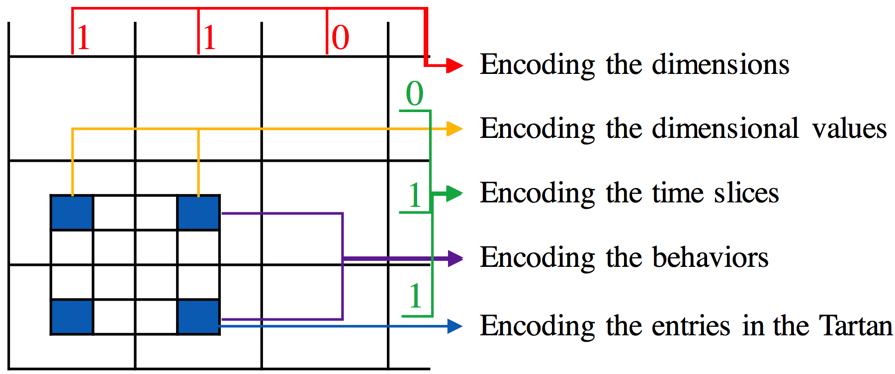
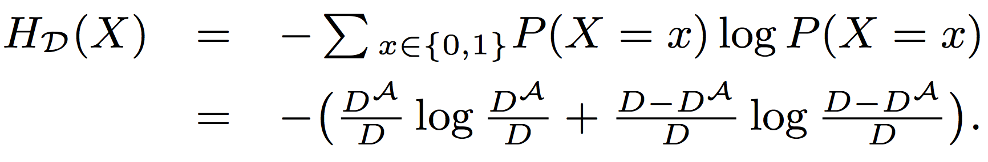
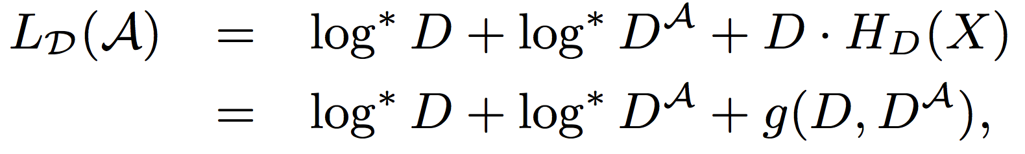
Encoding the Tartan: Dimensions

Slide 50
Encoding the Tartan: Dimensional Values

Slide 51
Encoding the Tartan: Time Slices

Slide 52
Encoding the Tartan: Behaviors

Slide 53
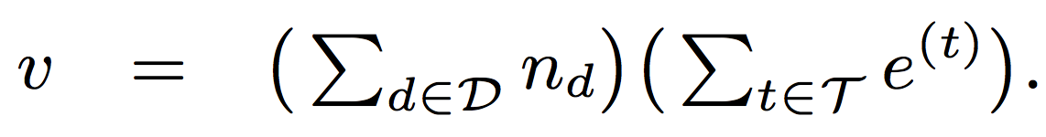
Encoding the Tartan: Entries

Slide 54
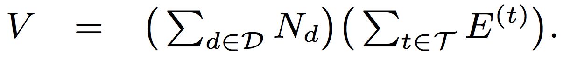
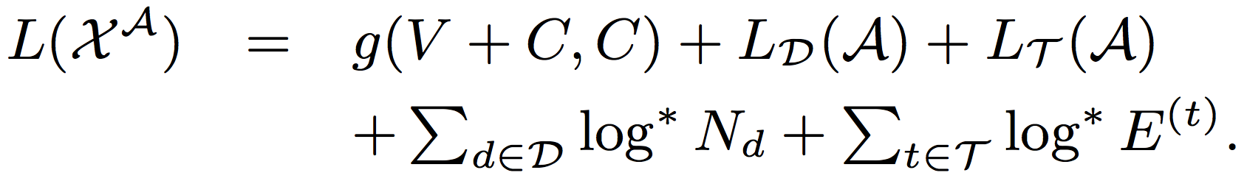
The Objective Function

Slide 55
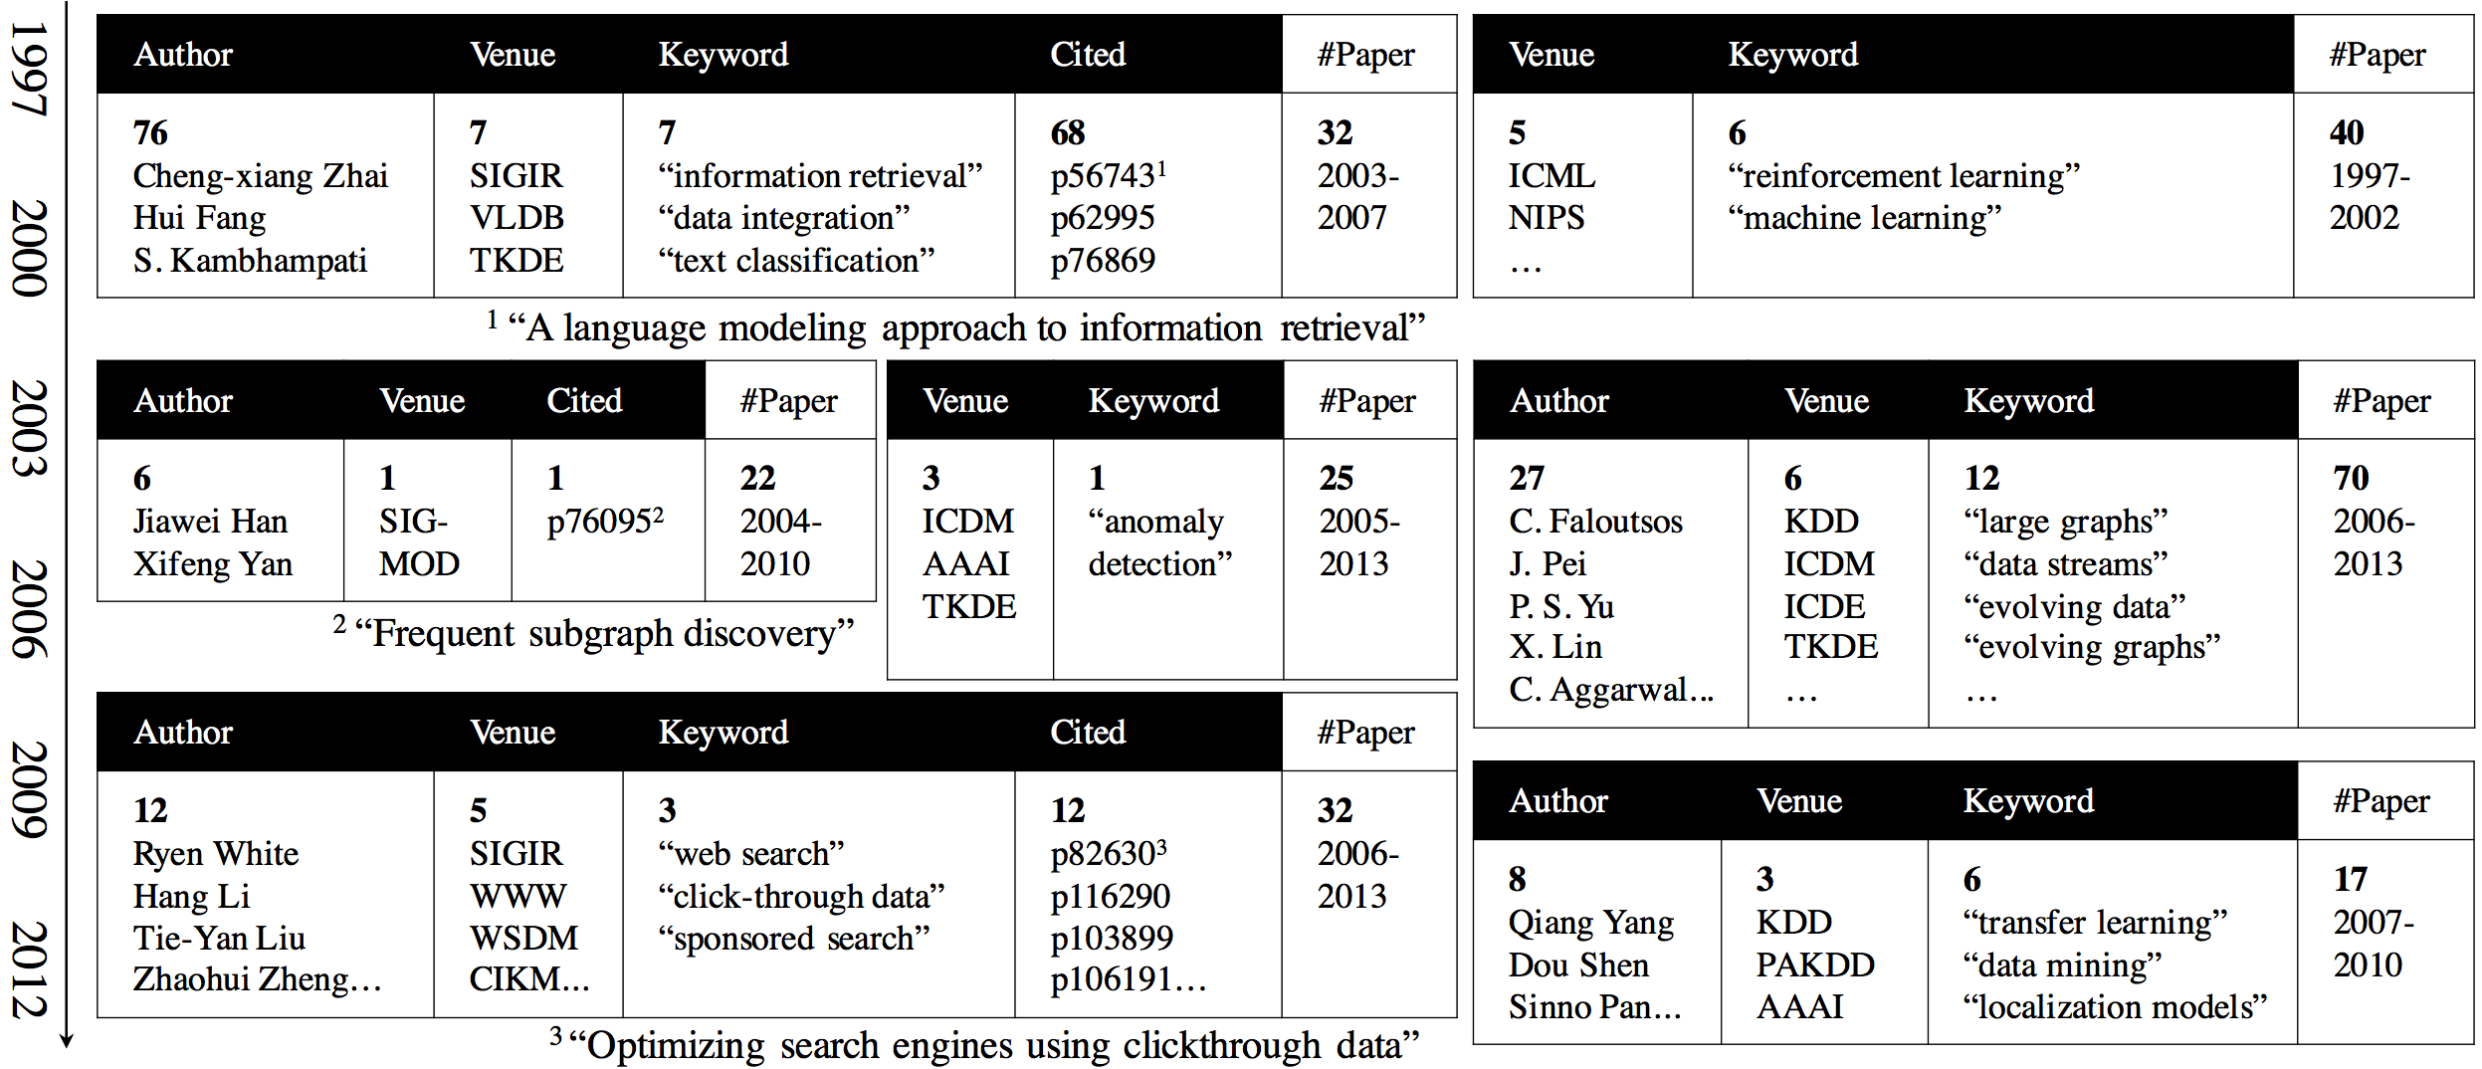
Results: DBLP

Slide 56
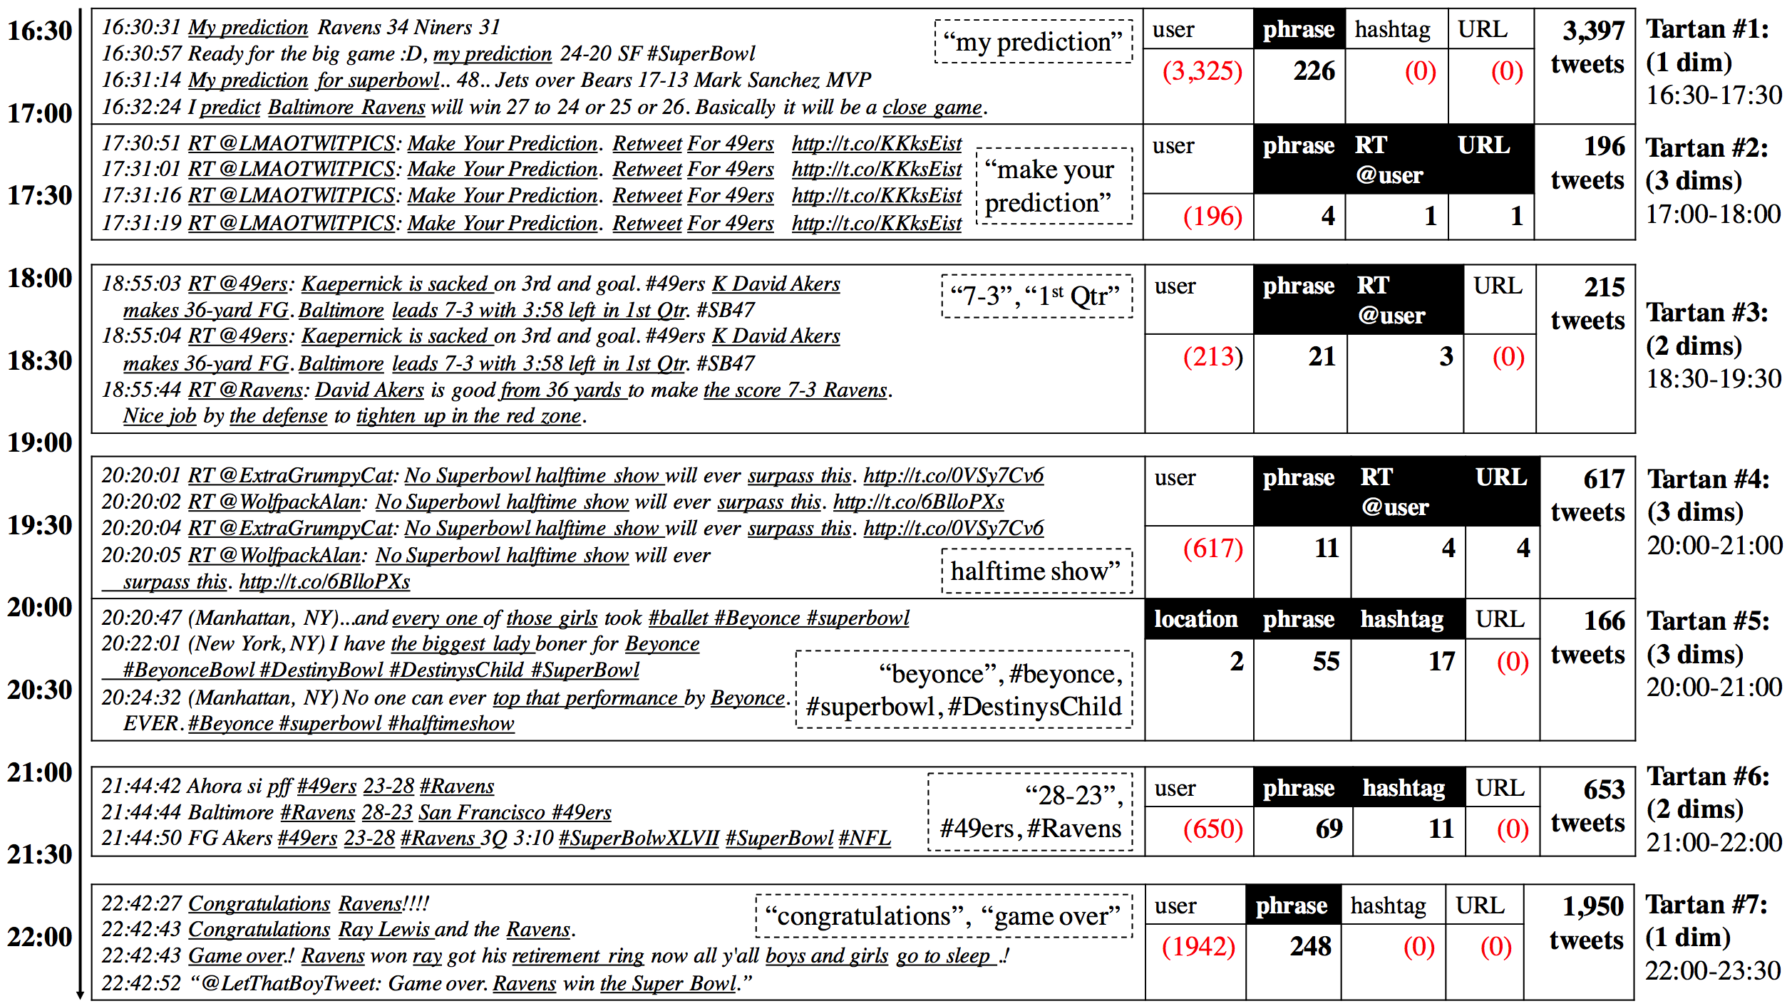
Results: Super Bowl 2013

Slide 57
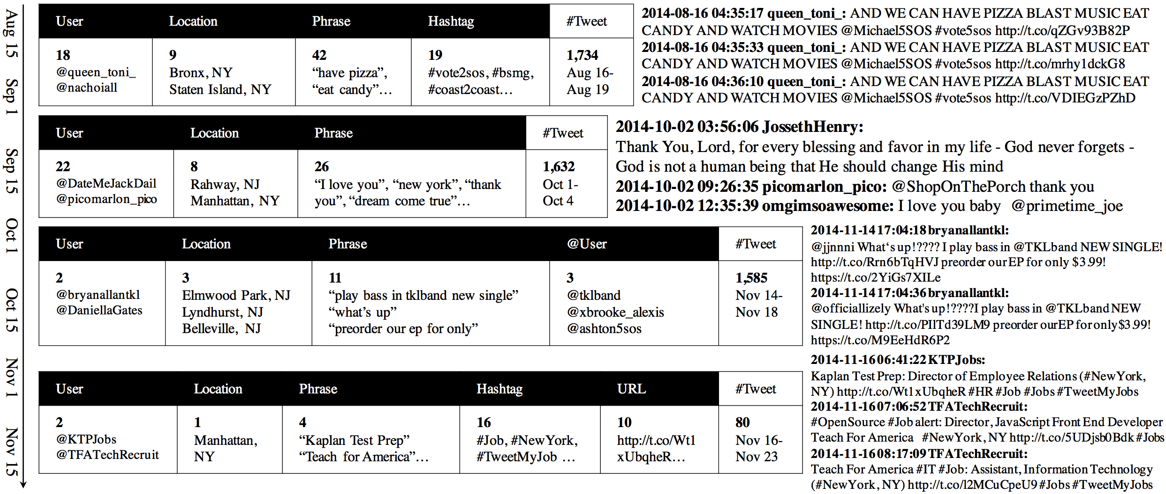
Results: NYC 2014

Slide 58
Data-Driven Behavioral Analytics
Social
(CIKM’12, TKDE’14)
Context
Spatiotemporal
(KDD’14)
Prediction and Recommendation
Content
Aspect and Attribute Mining
Summarization
(KDD’16)
Cross-Domain
(CIKM’12, TKDE’15)
Source
Cross-Platform
(AAAI’16)
Intention
Spotting and Catching
(WWW’14, PAKDD’14, KDD’14 Best Paper Finalist, KAIS’15, TKDD’16)
Suspicious Behavior Detection
(ISSI’16)
Evaluating Suspiciousness
(ICDM’15, TKDE’16)

Slide 59
References
[1] Meng Jiang, Peng Cui, Christos Faloutsos. “Suspicious Behavior Detection: Current Trends and Future Directions”, IEEE Intelligent Systems (ISSI) 2016. (Survey paper, IF=2.34)
[2] Meng Jiang, Peng Cui, Alex Beutel, Christos Faloutsos, Shiqiang Yang. “CatchSync: Catching Synchronized Behavior in Large Directed Graphs”, ACM SIGKDD 2014 Best Paper Finalist.
[3] Meng Jiang, Alex Beutel, Peng Cui, Bryan Hooi, Shiqiang Yang, Christos Faloutsos. “A General Suspiciousness Metric for Dense Blocks in Multimodal Data”, IEEE ICDM 2015.
[4] Meng Jiang, Alex Beutel, Peng Cui, Bryan Hooi, Shiqiang Yang, Christos Faloutsos. “Spotting Suspicious Behaviors in Multimodal Data: A General Metric and Algorithms”, IEEE TKDE 2016. (IF=2.07)
[5] Meng Jiang, Christos Faloutsos, Jiawei Han. “CatchTartan: Representing and Summarizing Dynamic Multicontextual Behaviors”, ACM SIGKDD 2016. (Oral presentation, ACC=8.9%)

Slide 60
Thank you!

Slide 61
Results (CatchSync)
CatchSync+SPOT
CatchSync
SPOT
OutRank
CatchSync+SPOT
CatchSync
SPOT
OutRank

Slide 62
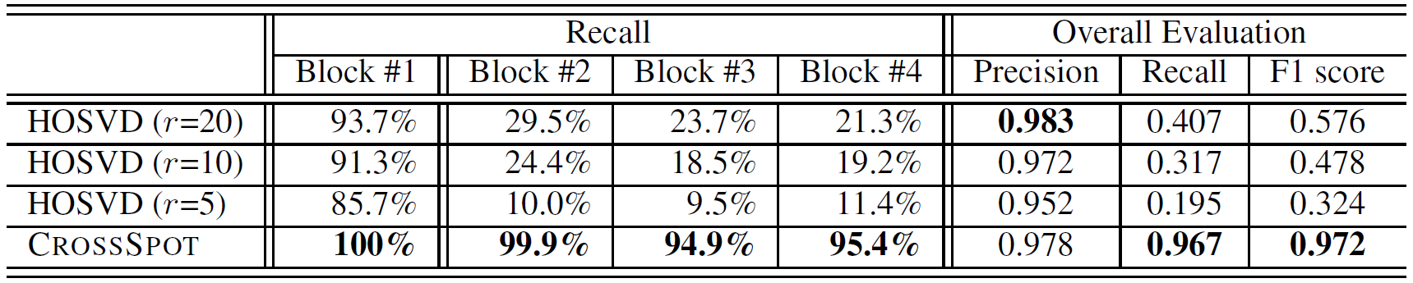
Results (CrossSpot)
Synthetic data
1,000×1,000×1,000 of 10,000 random data
Block#1: 30×30×30 of 512 3 modes
Block#2: 30×30×1,000 of 512 2 modes
Block#3: 30×1,000×30 of 512 2 modes
Block#4: 1,000×30×30 of 512 2 modes

Slide 63
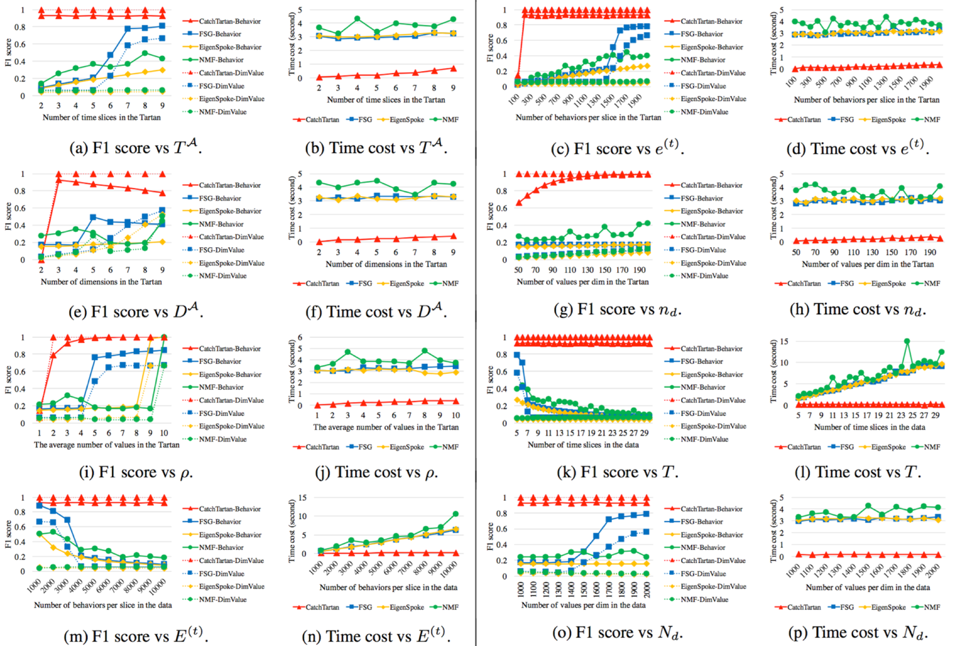
Results (CatchTartan)

Slide 64
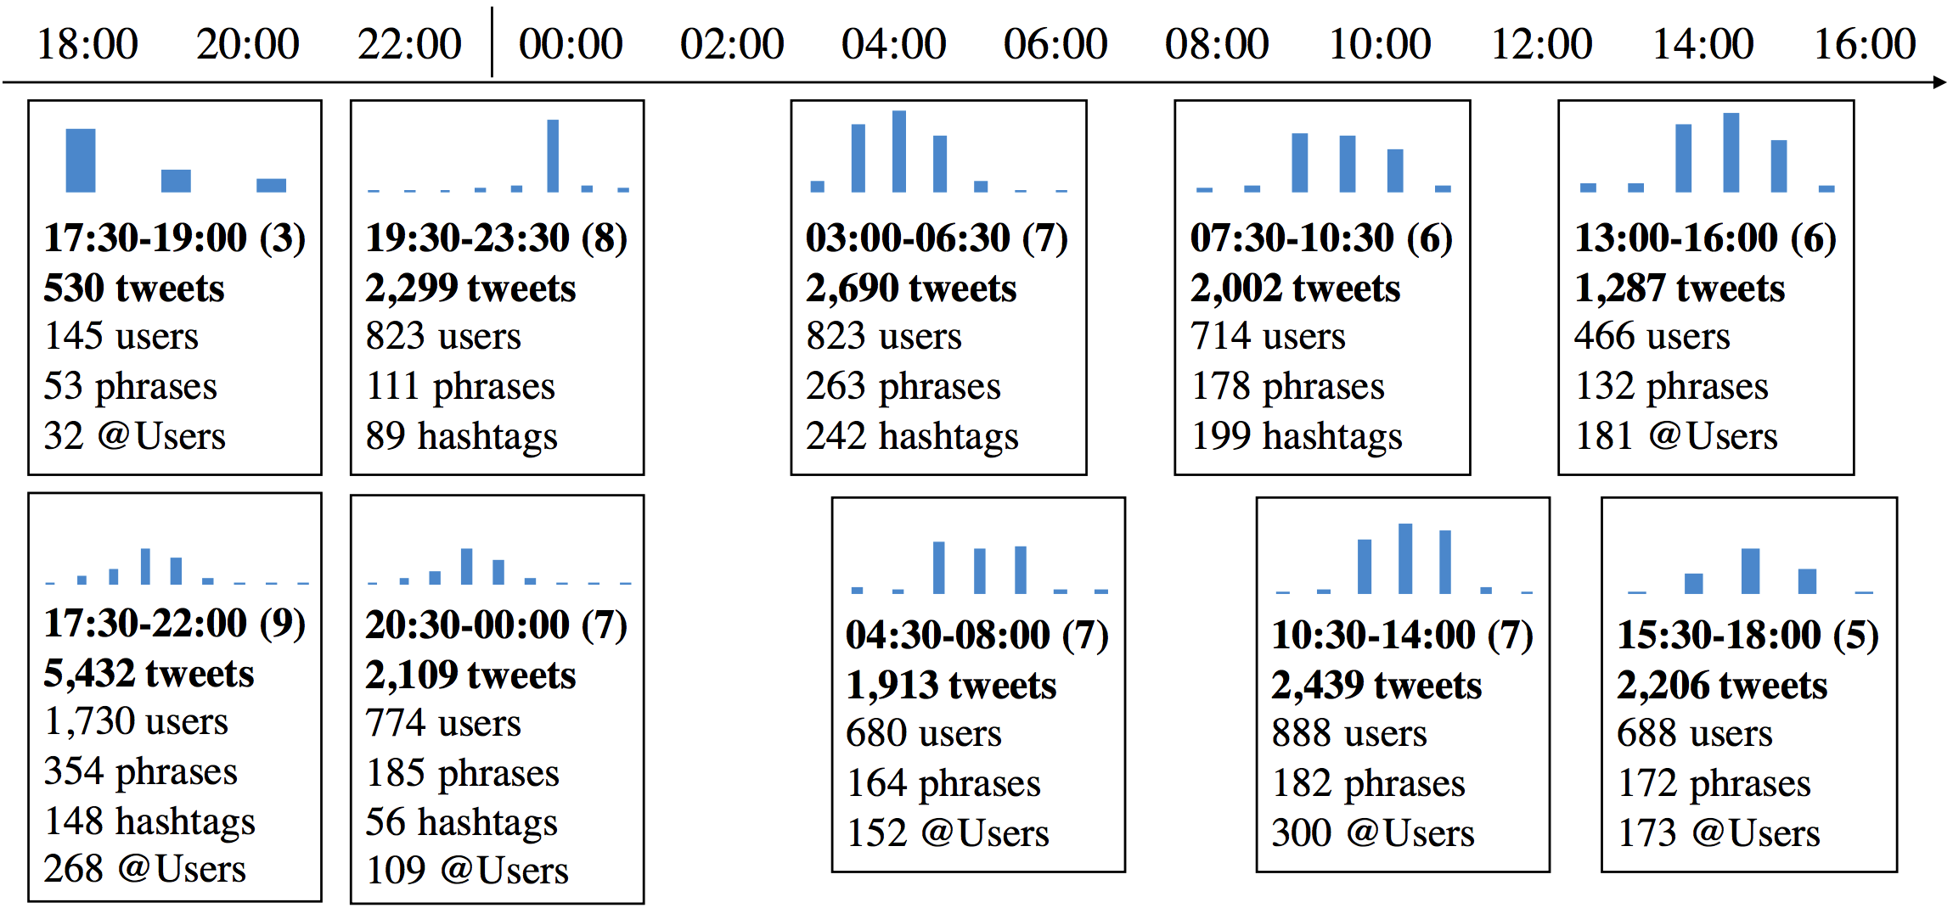
Results (CatchTartan): Grammy 2013

Slide 65

Results (CatchTartan): LA 2014

Slide 66


Results (CatchTartan)

